Slide 1
GraphQL on ASP.NET Core
WITH

Slide 2


Slide 3
GraphQL on ASP.NET Core
WITH

Slide 4
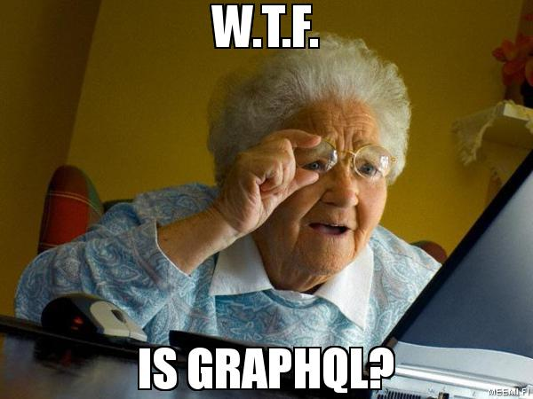

Slide 5

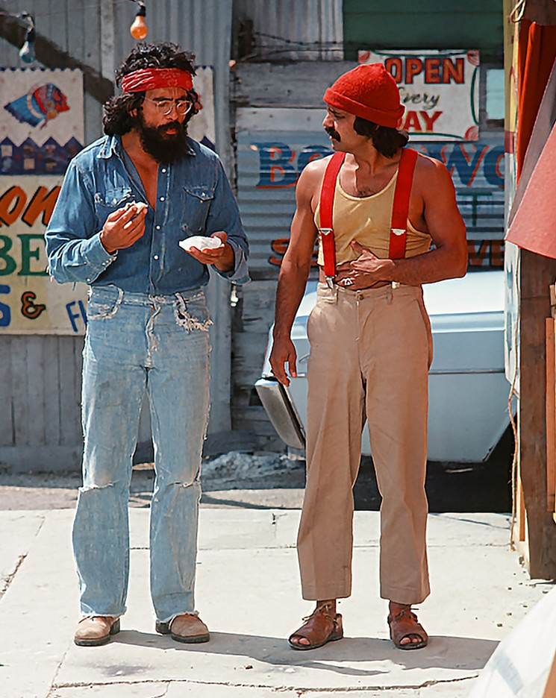
Who are we?

Slide 6

Who is this for?
Who is this for?

Slide 7
Demo

Slide 8



Slide 9
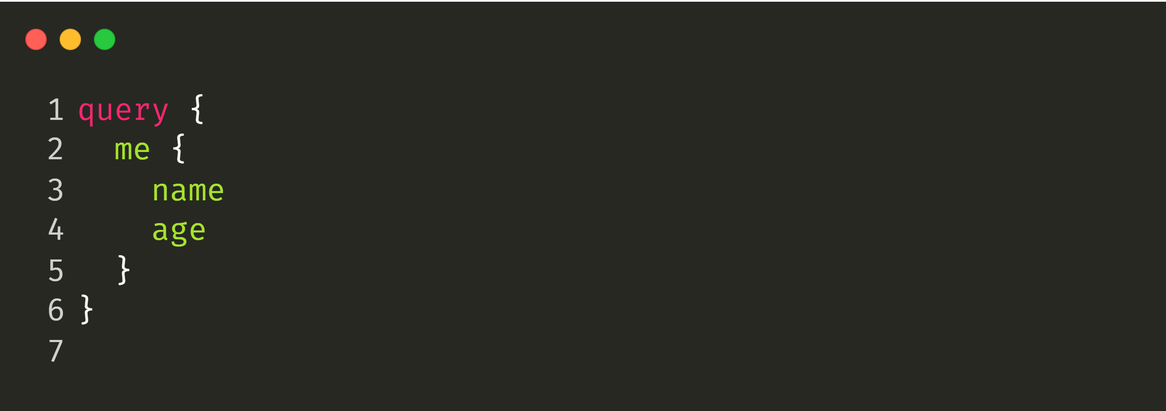
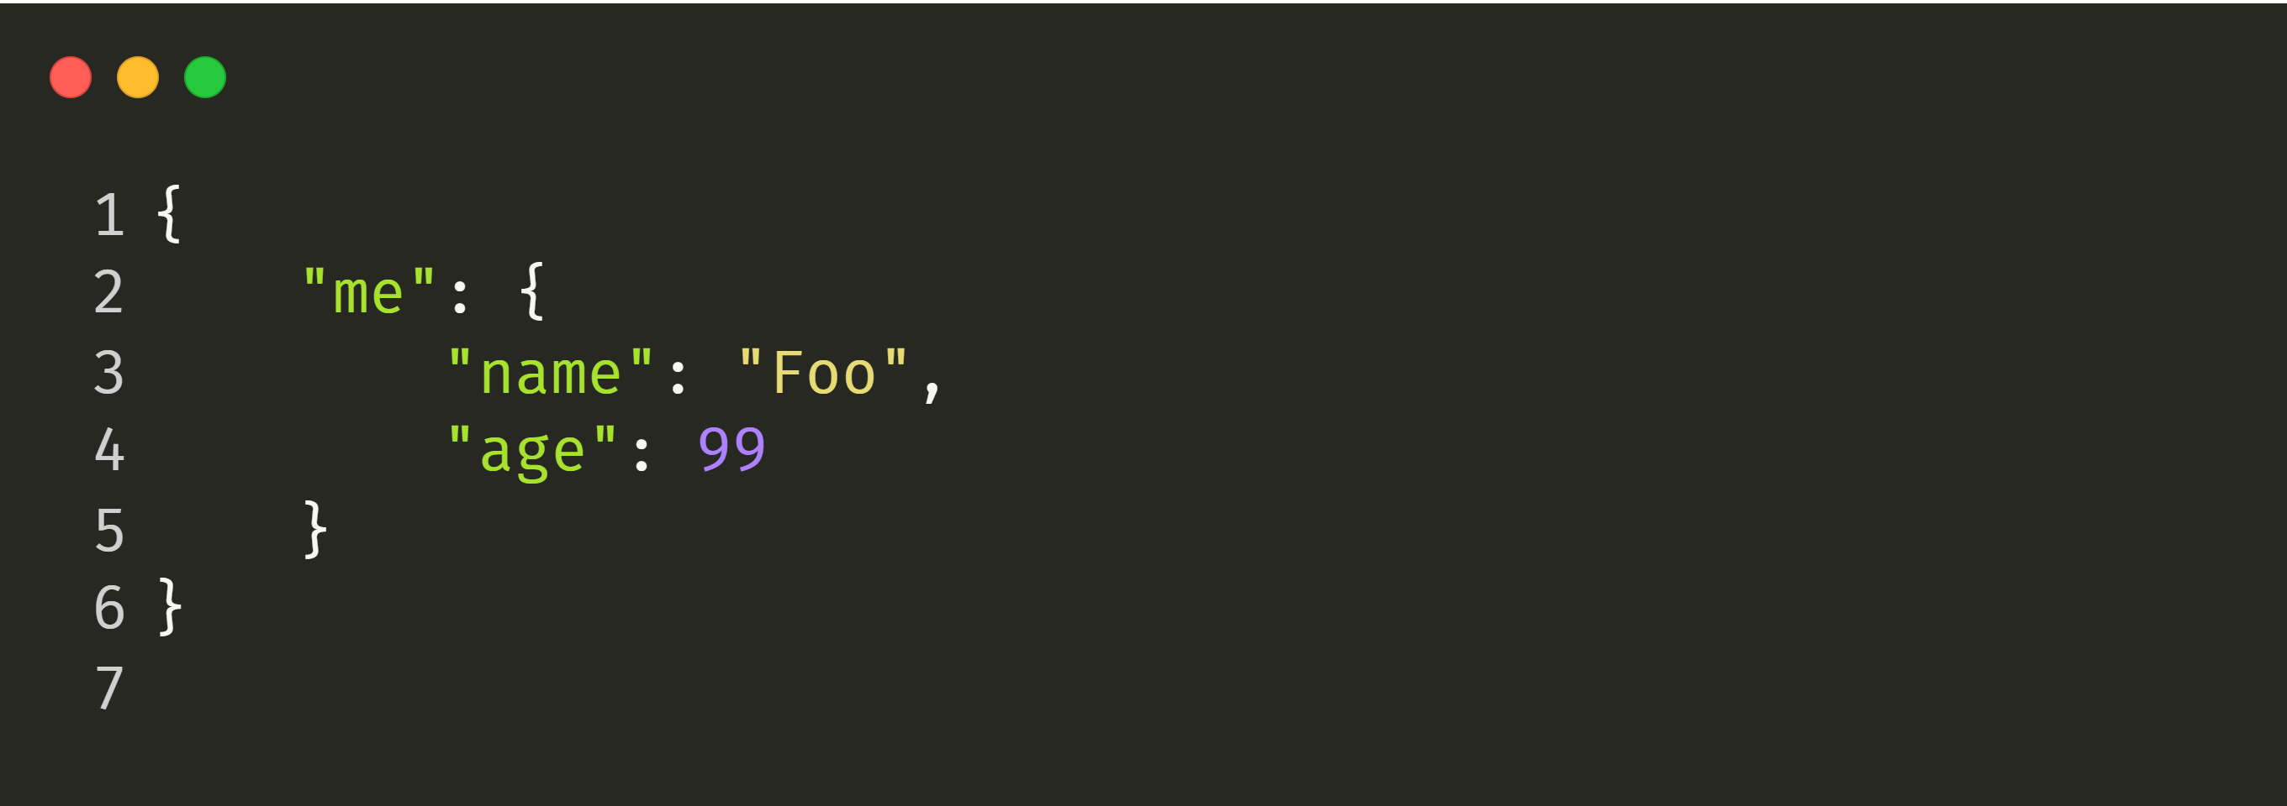

Slide 13
GET https://webservices.amazon.com/onca/xml?
Service=AWSECommerceService&
AWSAccessKeyId=mY-Sup3r-s3cr3!-k3y&
AssociateTag=12345&
Operation=ItemLookup&
ItemId=0316067938&
ResponseGroup=Reviews&
TruncateReviewsAt=256&
IncludeReviewsSummary=False&
Version=2013-08-01&
Timestamp=[YYYY-MM-DDThh:mm:ssZ]&
Signature=[Request Signature]
Notes:
https://www.ics.uci.edu/~fielding/pubs/dissertation/rest_arch_style.htm

Slide 14
What is GraphQL?

Slide 15
GraphQL
One Endpoint
No over- or under-fetching
Simplicity
Real-time
Predictability
No versioning
One Request
Type System
Documentation

Slide 16
Demo

Slide 17


Slide 18
Read | Query | GET
 |  | PUT, POST, PATCH DELETE
Events | Subscriptions | N/A
Write | Mutation | PUT, POST, PATCH DELETE
Operation | GraphQL | REST

Slide 19
Demo

Slide 20
What GraphQL is not:
Graph database query language
Solution for binary streams
Facebooks version of OData
Bound to a specific data source
Limited to HTTP
Limited to the JavaScript world

Slide 21
Challenges with GraphQL:
Fetching data in a consistent way throughout your graph
Scaling a single graph to multiple projects
Estimating the performance impact of requests
Implementing rate limits

Slide 22
Fetching Data

Slide 23
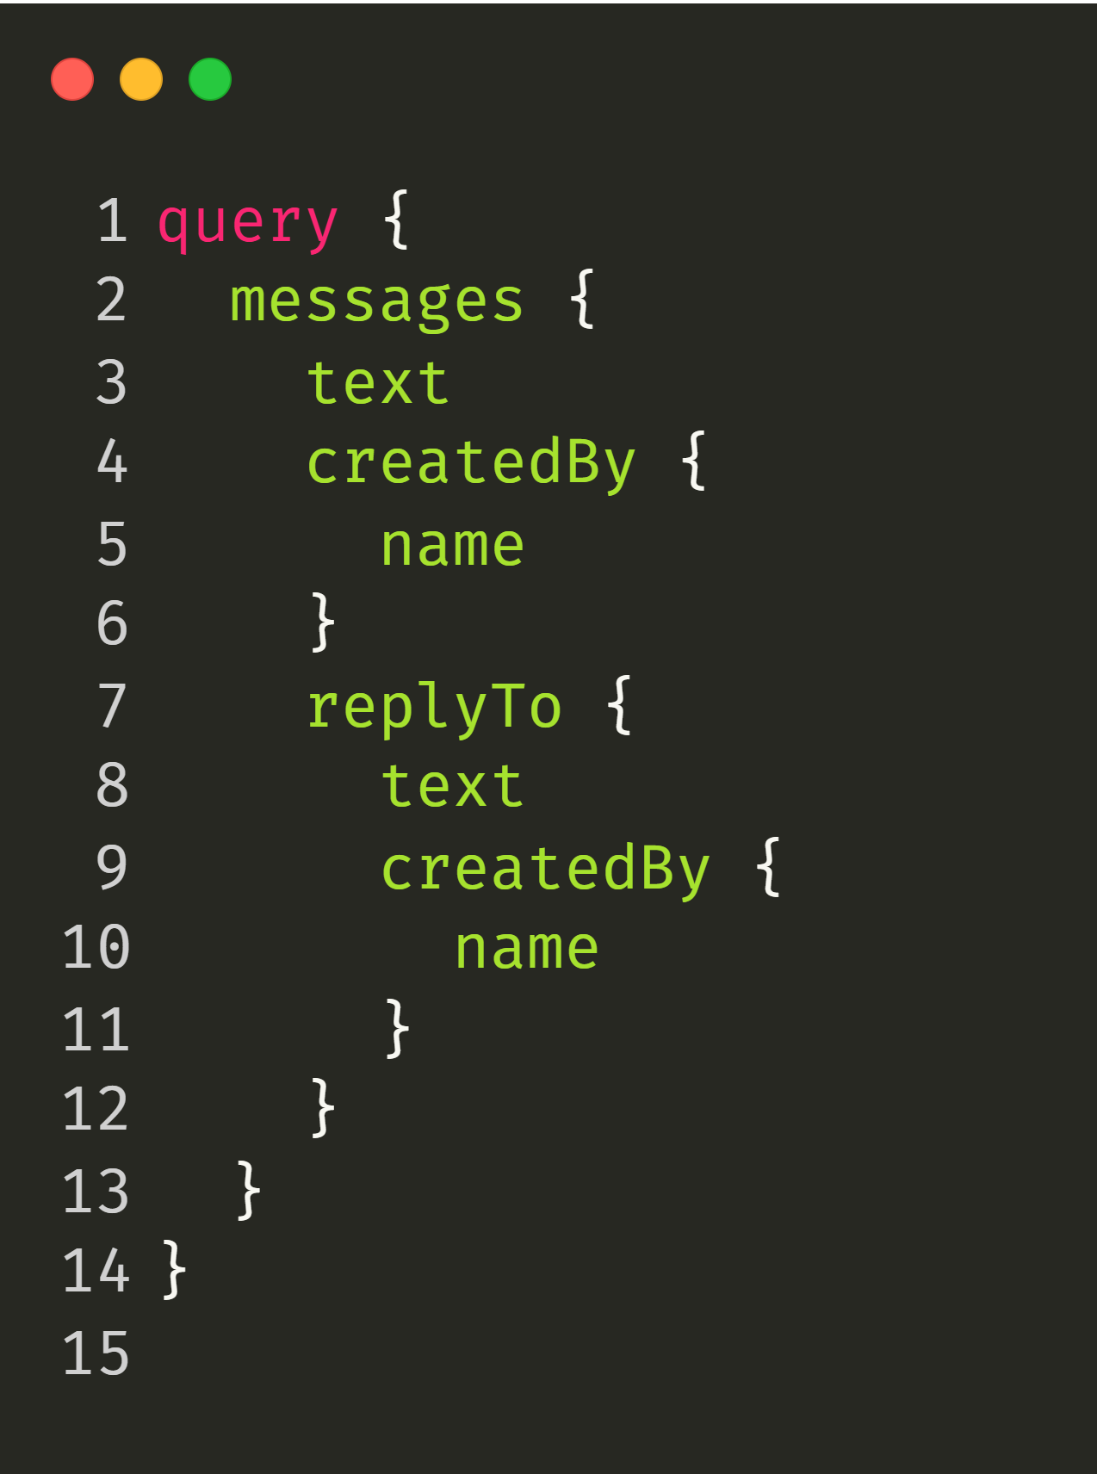

Slide 24
DB
Resolver
Resolver
Resolver
Resolver
DataLoader
Resolver
Resolver
Cache
Resolver
Resolver
Resolver
Resolver
Resolver

Slide 25
Demo

Slide 26
Scaling Your Graph

Slide 27
High Bandwidth Usage
GraphQL Client
{
"query" : <query>
}
GraphQL Server

Slide 28
Unrestricted Query Execution
GraphQL Client
{
"query" : <query>
}
GraphQL Server

Slide 29
Low Bandwidth Usage
GraphQL Client
{
“id” : “W5IYenw==”
}
GraphQL Server
Middleware

Slide 30
Restricted Query Execution
GraphQL Client
{
“id” : “W5IYenw==”
}
GraphQL Server
Middleware

Slide 31
Demo

Slide 32
What do GraphQL clients actually look like on .NET?

Slide 33
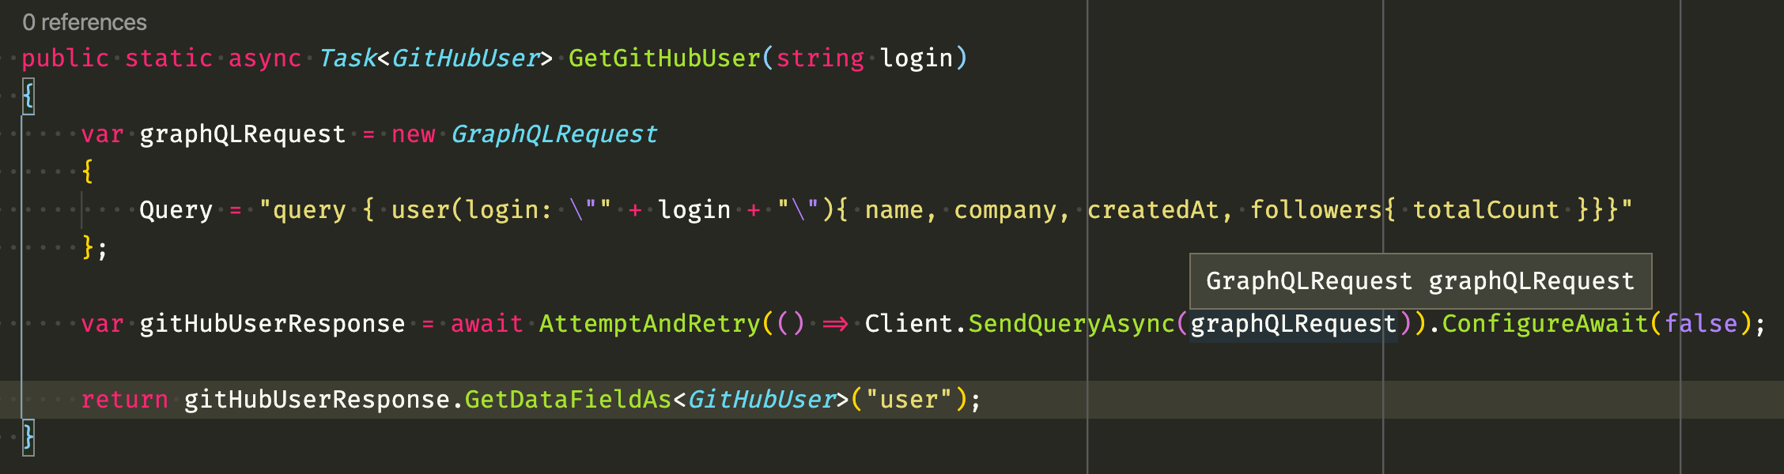

Slide 36
Demo

Slide 37
Testing your Schema

Slide 38


Slide 39
Demo

Slide 40
Conclusion:
GraphQL is a great way to expose APIs in a more human-readable way
Data fetching and aggregation is moved into the server
The type system protects the consumer from malformed data
GraphQL introduces new challenges for scaling APIs
GraphQL is NOT always a good solution (e.g. Binary Streams)

Slide 41
Building a GraphQL Server

Slide 42
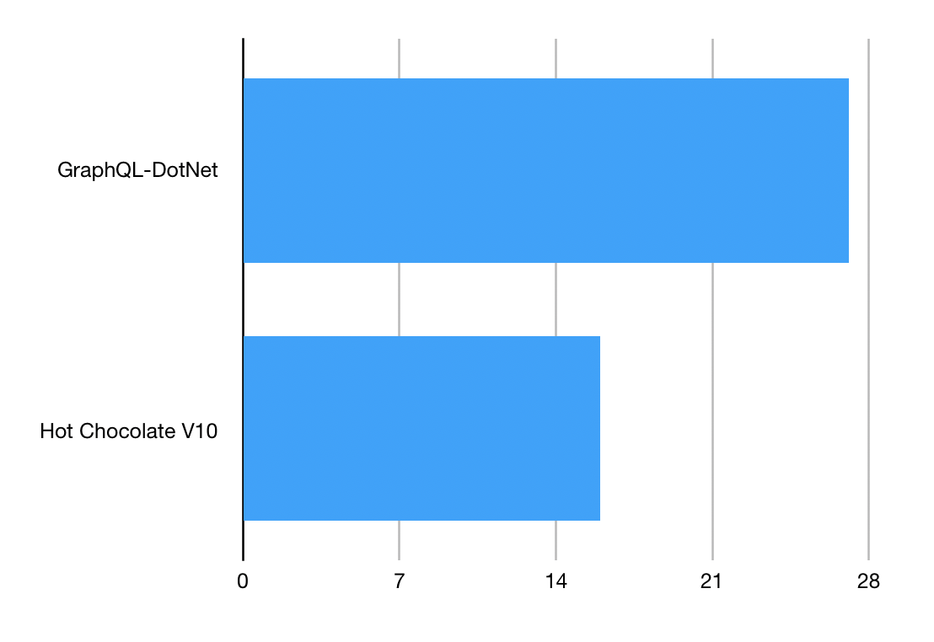
Speed:

Slide 43
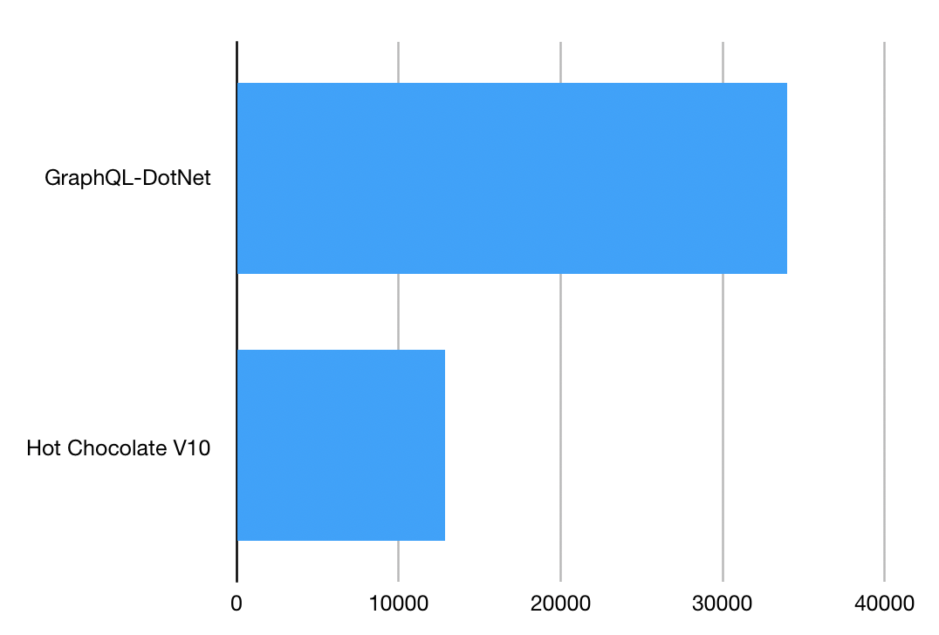
Memory:

Slide 44
Outlook

Slide 45
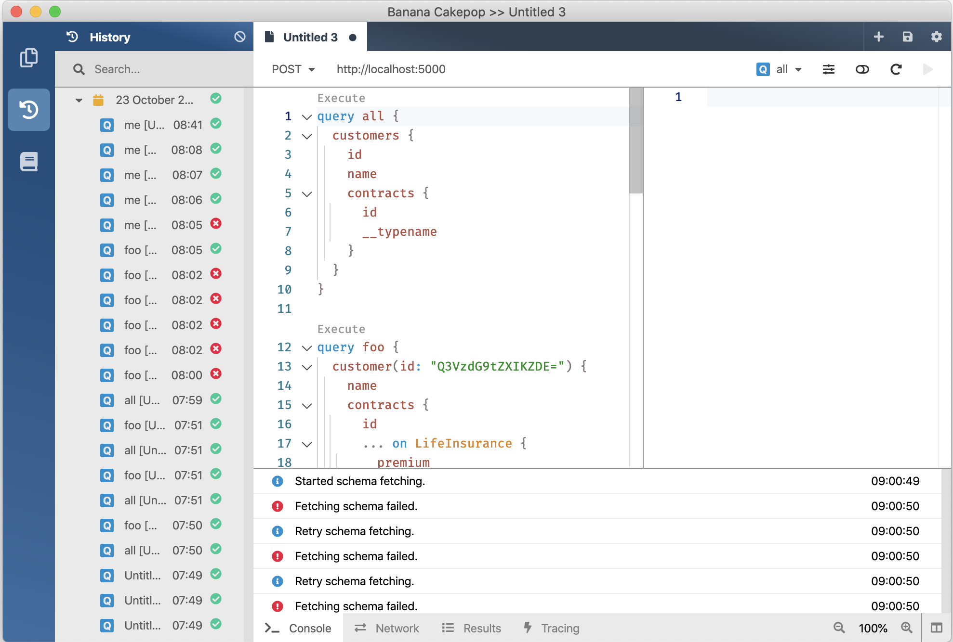
V10
GraphQL Gateway
V11 January 2020
V12 August 2020
GraphQL Client
GraphQL Server
Developer Tooling
Supports Blazor and Xamarin
Execution Plans @defer @stream
Schema Registry (Schema Change Tracking, CI Tools)
Automatic Database Mapping
GraphQL Analytics
Operations Manager (Execution Plan Store, Whitelisting, Client Registry)

Slide 46
Where do you find us?
https://hotchocolate.io
https://chillicream.com
http://bit.ly/canary_wharf_2019
https://twitter.com/Chilli_Cream
https://github.com/ChilliCream

